Slide 1
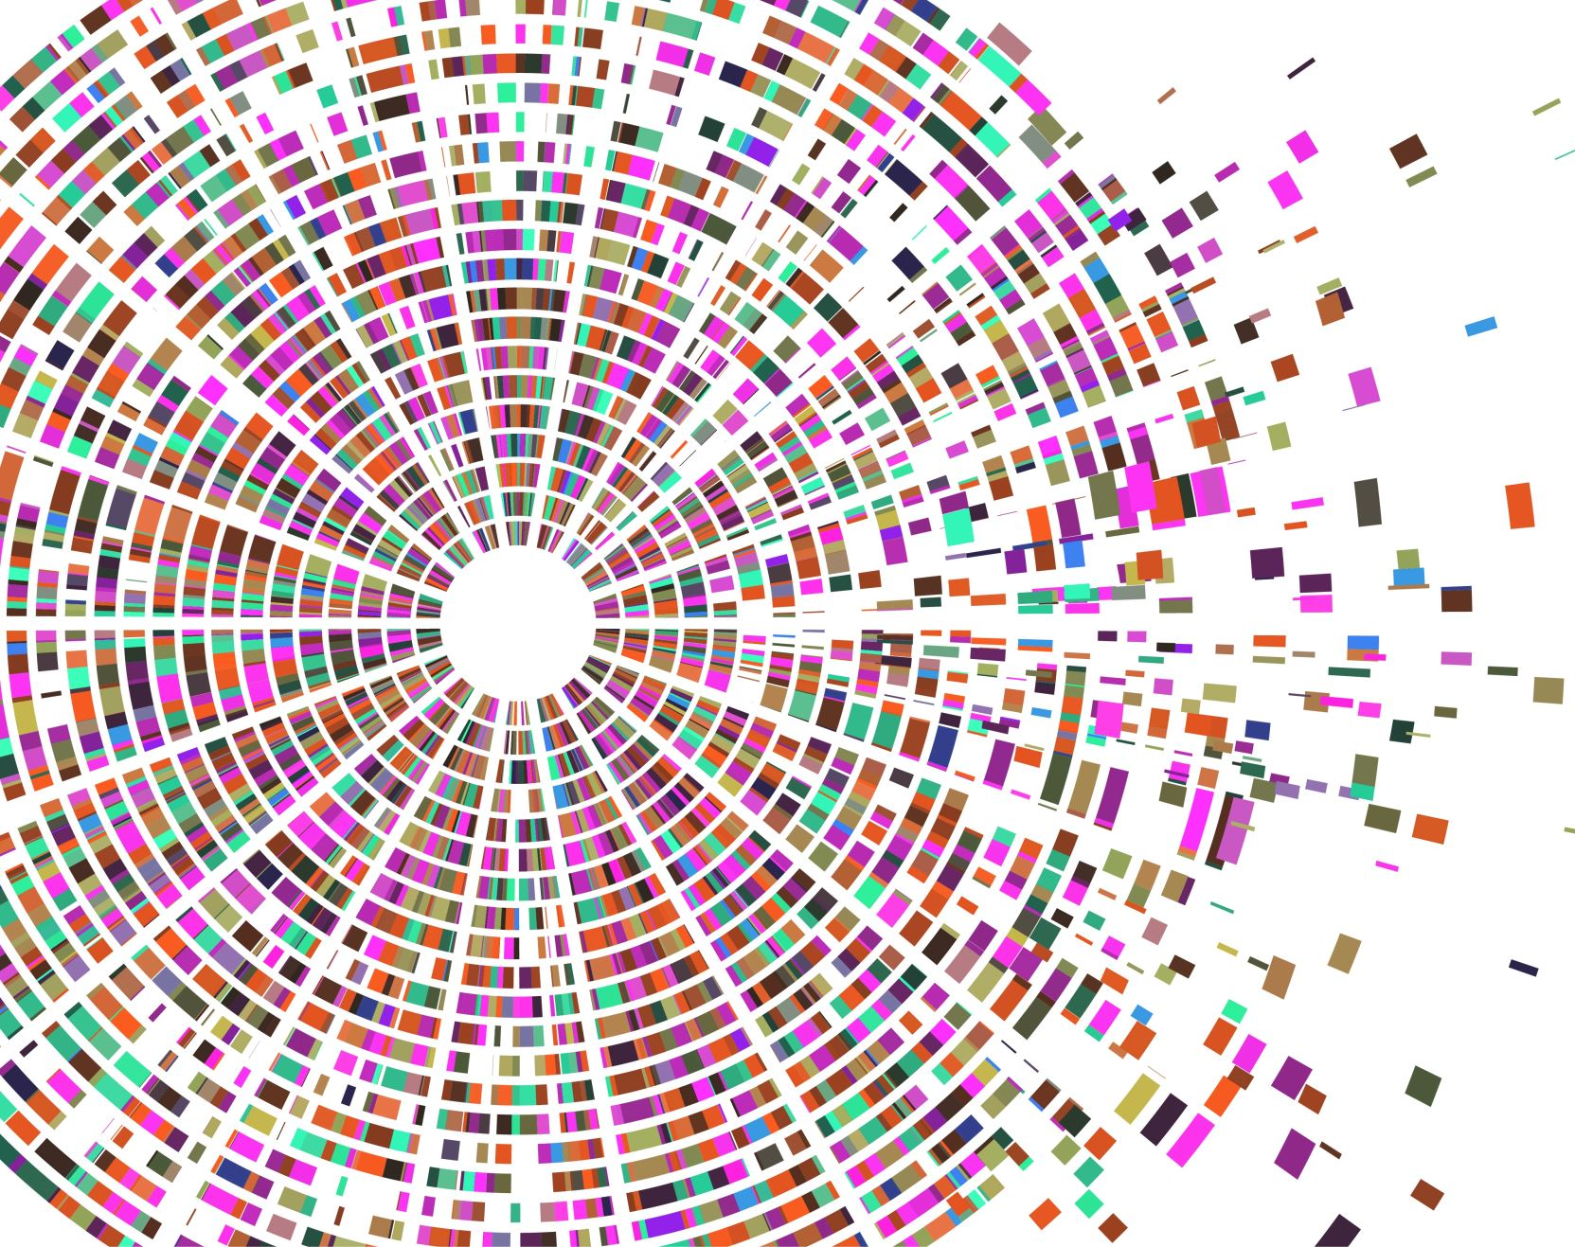
Seaborn
Musadaq Mansoor

Slide 2
Data Visualization
Data Visualization is the presentation of data in pictorial format.
It is extremely important for Data Analysis because it helps to understand the data.
Presenting a huge amount of data in a simple and easy-to-understand format helps communicate information clearly and effectively.

Slide 3
Seaborn
Seaborn is an amazing visualization library for statistical graphics plotting in Python.
It is built on the top of the matplotlib library and is closely integrated into the data structures from pandas.

Slide 4
Installation
For python environment
pip install seaborn
For conda environment
conda install seaborn

Slide 5

Loading Data
import pandas
# load the csv
data = pandas.read_csv("nba.csv")
# show first 5 column
data.head()

Slide 6
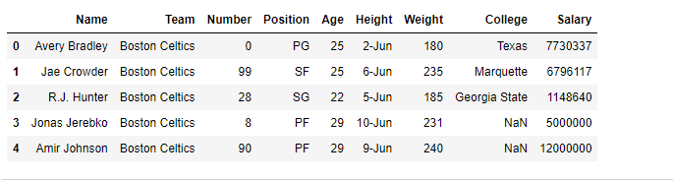

Slide 7
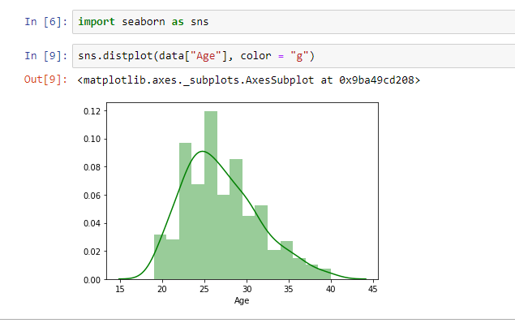

Slide 8
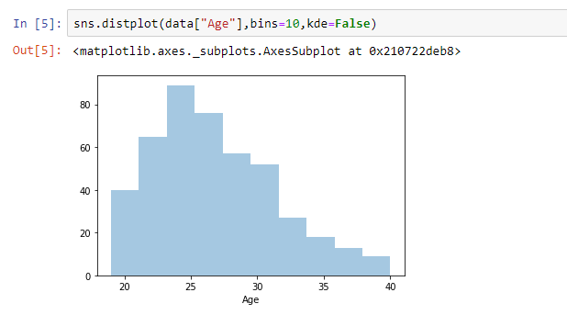

Slide 9
Lineplot
Lineplot Is the most popular plot to draw a relationship between x and y with the possibility of several semantic groupings.
Syntax : sns.lineplot(x=None, y=None)
Parameters:
x, y: Input data variables; must be numeric. Can pass data directly or reference columns in data.

Slide 10
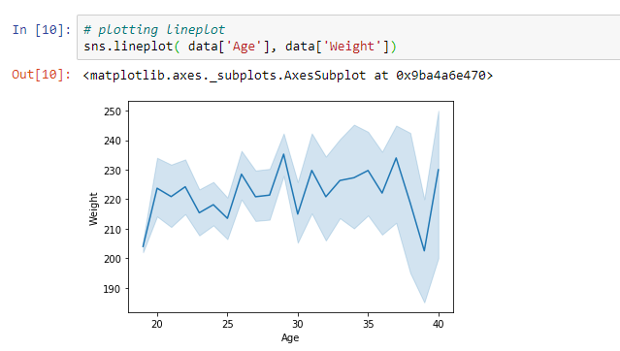

Slide 11
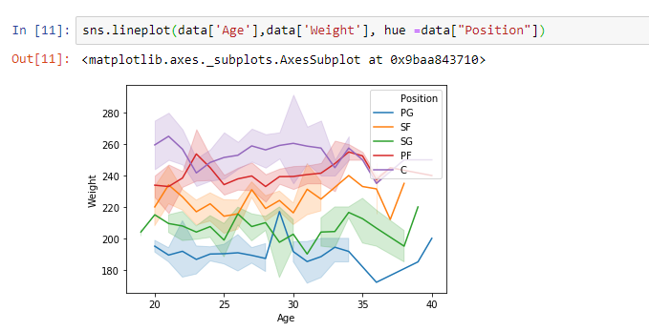

Slide 12

Scatterplot
Scatterplot Can be used with several semantic groupings which can help to understand well in a graph against continuous/categorical data. It can draw a two-dimensional graph.
Syntax: seaborn.scatterplot(x=None, y=None)
Parameters:
x, y: Input data variables that should be numeric.

Slide 13
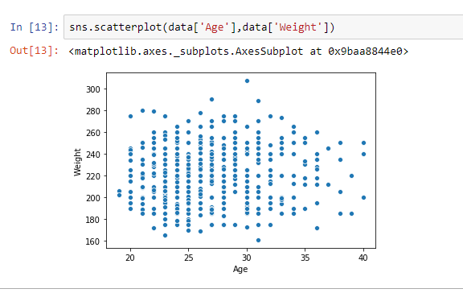

Slide 14
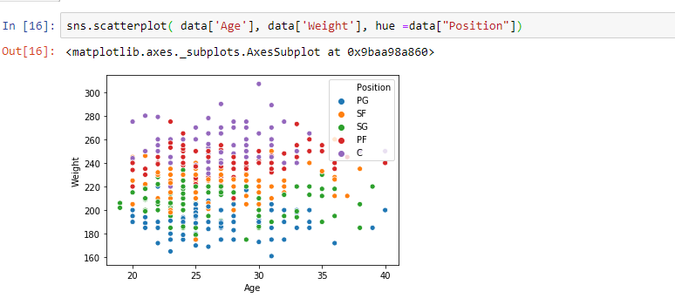

Slide 15
Box plot
A box plot is the visual representation of the depicting groups of numerical data through their quartiles against continuous/categorical data.
Syntax:
seaborn.boxplot(x=None, y=None, hue=None, data=None)
Parameters:
x, y, hue: Inputs for plotting long-form data.
data: Dataset for plotting. If x and y are absent, this is interpreted as wide-form.
Returns: It returns the Axes object with the plot drawn onto it.

Slide 16
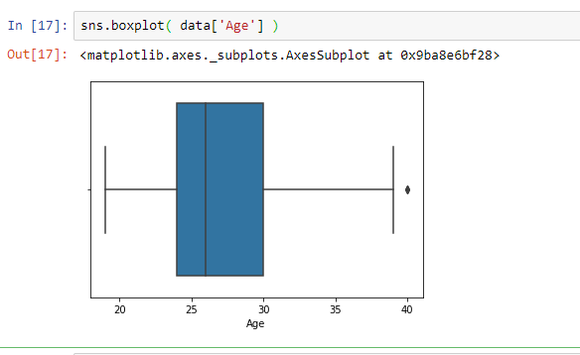

Slide 17
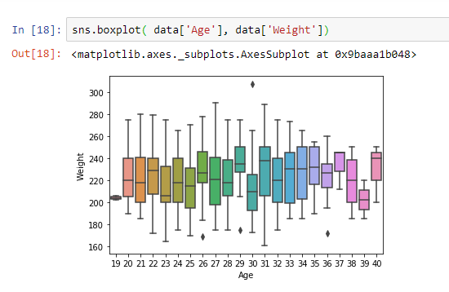

Slide 18
Violin Plot
A violin plot is like a boxplot. It shows several quantitative data across one or more categorical variables such that those distributions can be compared.
Syntax: seaborn.violinplot(x=None, y=None, hue=None, data=None)
Parameters:
x, y, hue: Inputs for plotting long-form data.
data: Dataset for plotting.

Slide 19
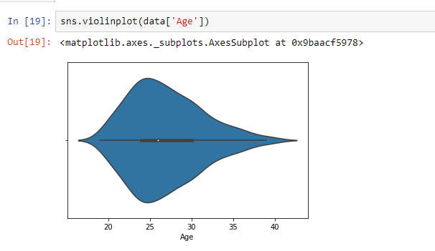

Slide 20
Count plot
A count plot is used to show the counts of observations in each categorical bin using bars.
Syntax: seaborn.countplot(x=None, y=None, hue=None, data=None)
Parameters :
x, y: This parameter takes names of variables in data or vector data, optional, Inputs for plotting long-form data.
Hue: (optional) This parameter takes the column name for colour encoding.
Data: (optional) This parameter takes DataFrame, array, or list of arrays, Dataset for plotting. If x and y are absent, this is interpreted as wide-form. Otherwise, it is expected to be long-form.

Slide 21
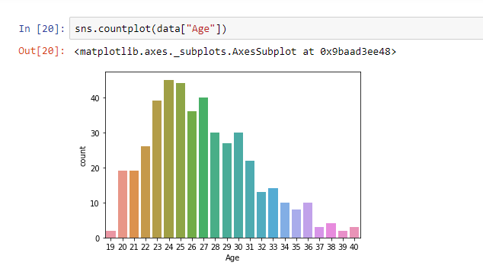

Slide 22
